Slide 1
Eden II
Gary Chi
Raisa Rabbani
Elon Xie
Jessica Z

Slide 2
Agenda
Problem Statement
Proposed Solution
Workflow Overview
Benefits
Mock up
Demo

Slide 3
Problem
Inconvenience for autistic child
No seamless transition between caretakers
Limited speech development
Notes:
30 sec Elon

Slide 4

Proposed solution
Intuitive and easy to use mobile app
Helps caretakers understand kids
Can retain unique language of each child
All made available to caretakers
Notes:
30 seconds Elon

Slide 5
Workflow overview
Initial: Users input audio data of phrases
Translation: Caretaker/Parent records the child speaking
This is translated to text
Editing: Translations can be edited if incorrect
Notes:
30 s gary

Slide 6
Benefits
Each caretaker’s app has its own pool of children to attend to
A database retains data for each individual
Compares data derived from audio with reference data
Notes:
30 sec gary

Slide 7
Eden II
Splash Screen
Notes:
1 min

Slide 8
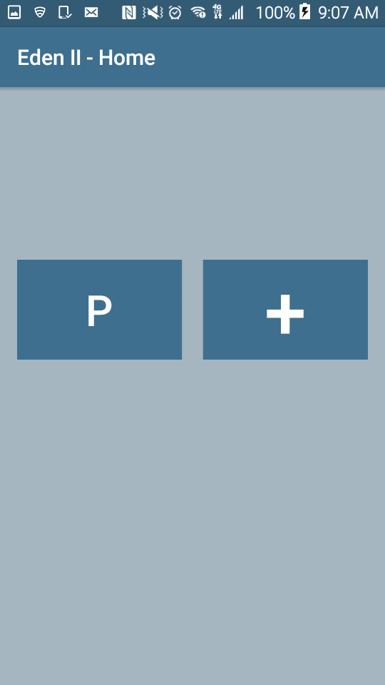
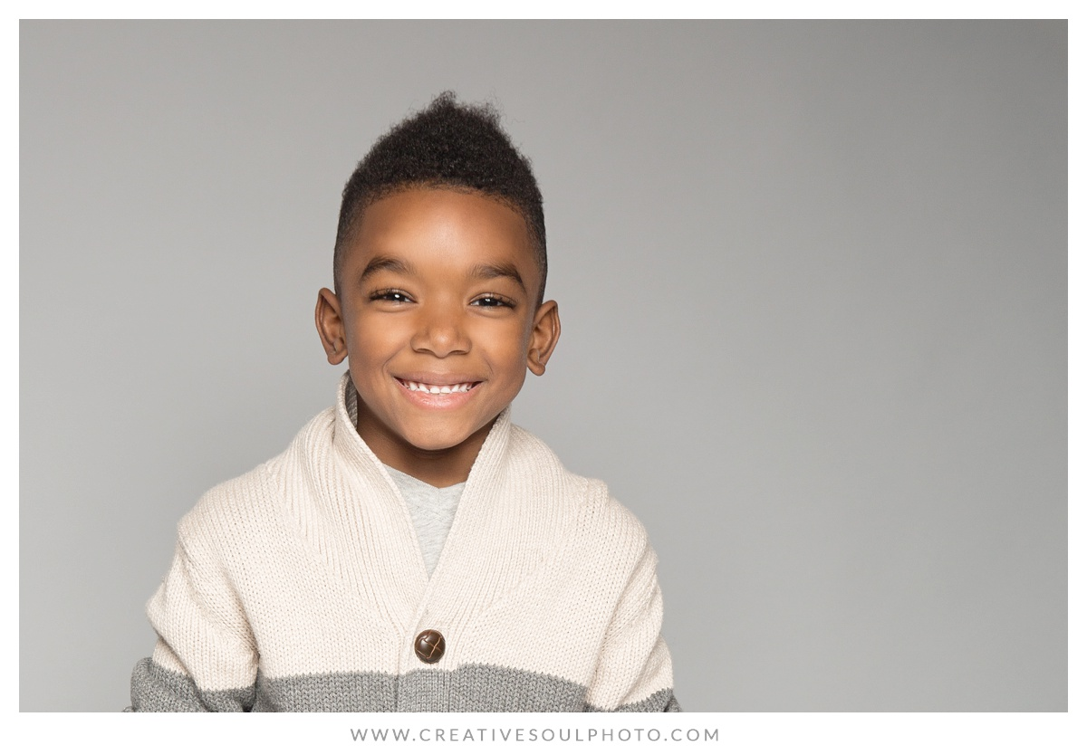
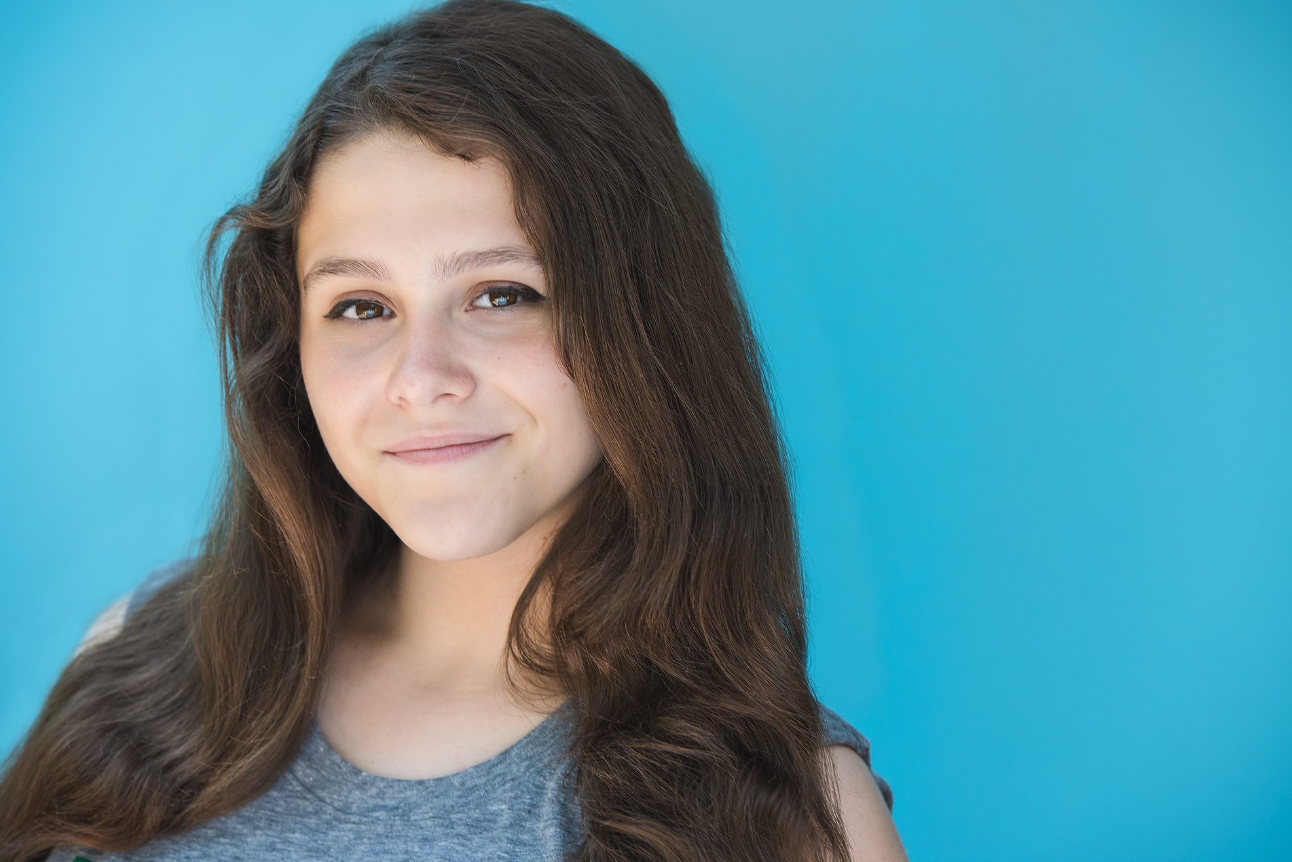
A
B
Albert Beth
Pearl Add
Even II
Home Screen

Slide 9
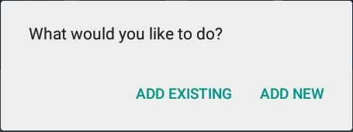
A
B
Albert Beth
Pearl Add
Even II
Home Screen

Slide 10
A
B
Albert Beth
Carl Pearl
Add
C
P
Even II
+
Home Screen

Slide 11
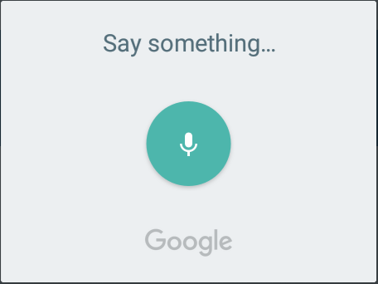
A
B
Albert Beth
Pearl Add
Even II
Home Screen

Slide 12
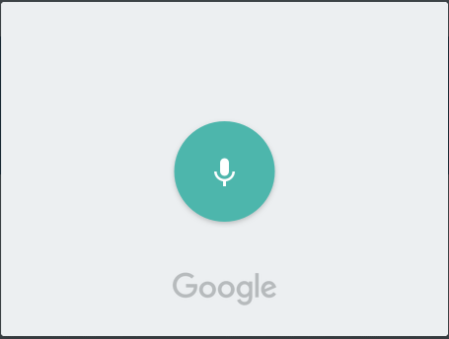
A
B
Albert Beth
Pearl Add
Abbaypa
Even II
Results Screen

Slide 13
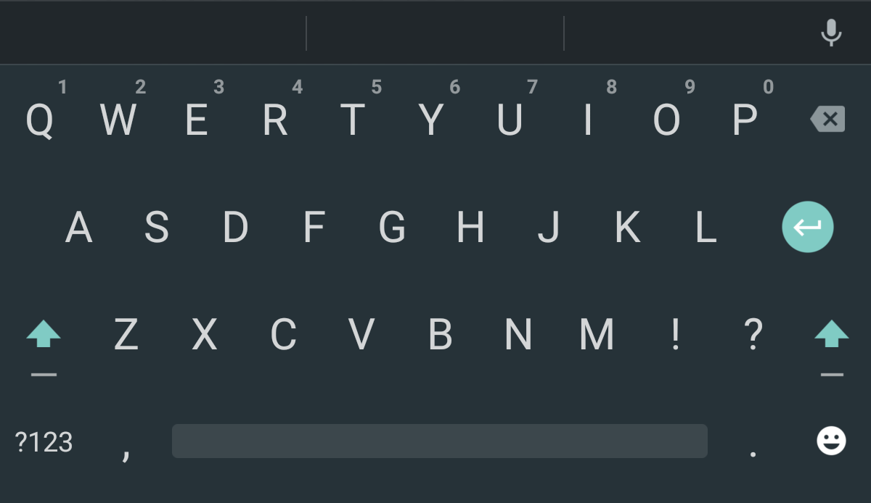
No results :(
What does this mean ?
A
B
Albert Beth
Pearl Add
Even II
✓
Results Screen

Slide 14
No results :(
What does this mean ?
A
B
Albert Beth
Pearl Add
want iPad
Even II
✓
Results Screen

Slide 15
A
B
Albert Beth
Pearl Add
Even II
Home Screen

Slide 16
A
B
Albert Beth
Pearl Add
Abbaypa
Even II
Results Screen

Slide 17
A
B
want
iPad
Albert Beth
Pearl Add
Even II
✓
Results Screen

Slide 18
A
B
want
iPad
Albert Beth
Pearl Add
Even II
✓
Results Screen

Slide 19
Demo
Notes:
1 min

Slide 20
Future Improvements
Complete minimally viable product (MVP)
Additional security in data transfer
Accounts for caretakers
Machine Learning/Audio fingerprinting
Notes:
Raisa 15 sec

Slide 21
Thank You For Listening
Questions?

